Slide 1
Unit 202: Principles of electrical science
Mathematical principles

Slide 2
Fractions
Fractions can be classified in two ways:
Vulgar fractions
Decimal fractions

Slide 3
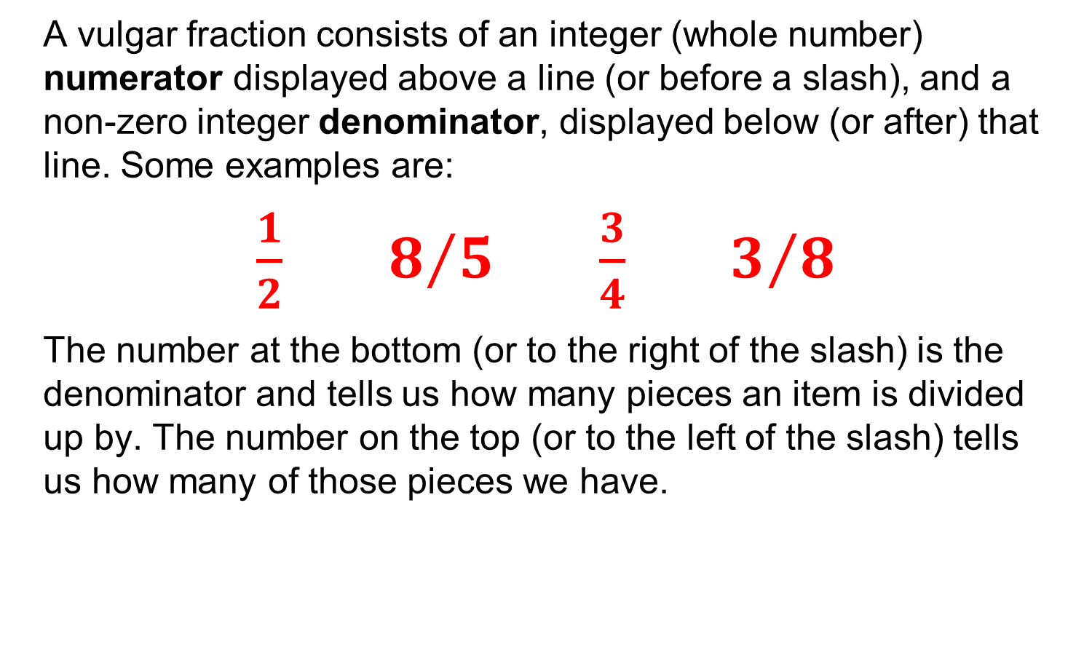
Vulgar fractions
A vulgar fraction consists of an integer (whole number) numerator displayed above a line (or before a slash), and a non-zero integer denominator, displayed below (or after) that line. Some examples are:
$\frac{1}{2}$ $8/5$ $\frac{3}{4}$ $3/8$
The number at the bottom (or to the right of the slash) is the denominator and tells us how many pieces an item is divided up by. The number on the top (or to the left of the slash) tells us how many of those pieces we have.

Slide 4
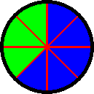
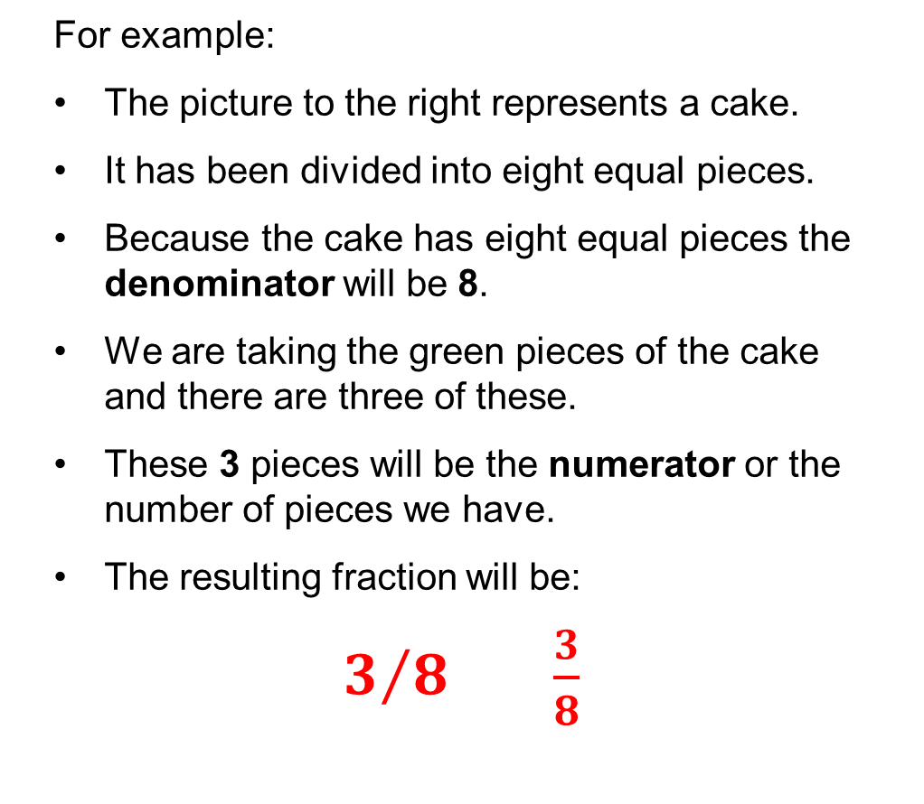
Vulgar fractions
For example:
The picture to the right represents a cake.
It has been divided into eight equal pieces.
Because the cake has eight equal pieces the denominator will be 8.
We are taking the green pieces of the cake and there are three of these.
These 3 pieces will be the numerator or the number of pieces we have.
The resulting fraction will be:
$3/8$ $\frac{3}{8}$

Slide 5
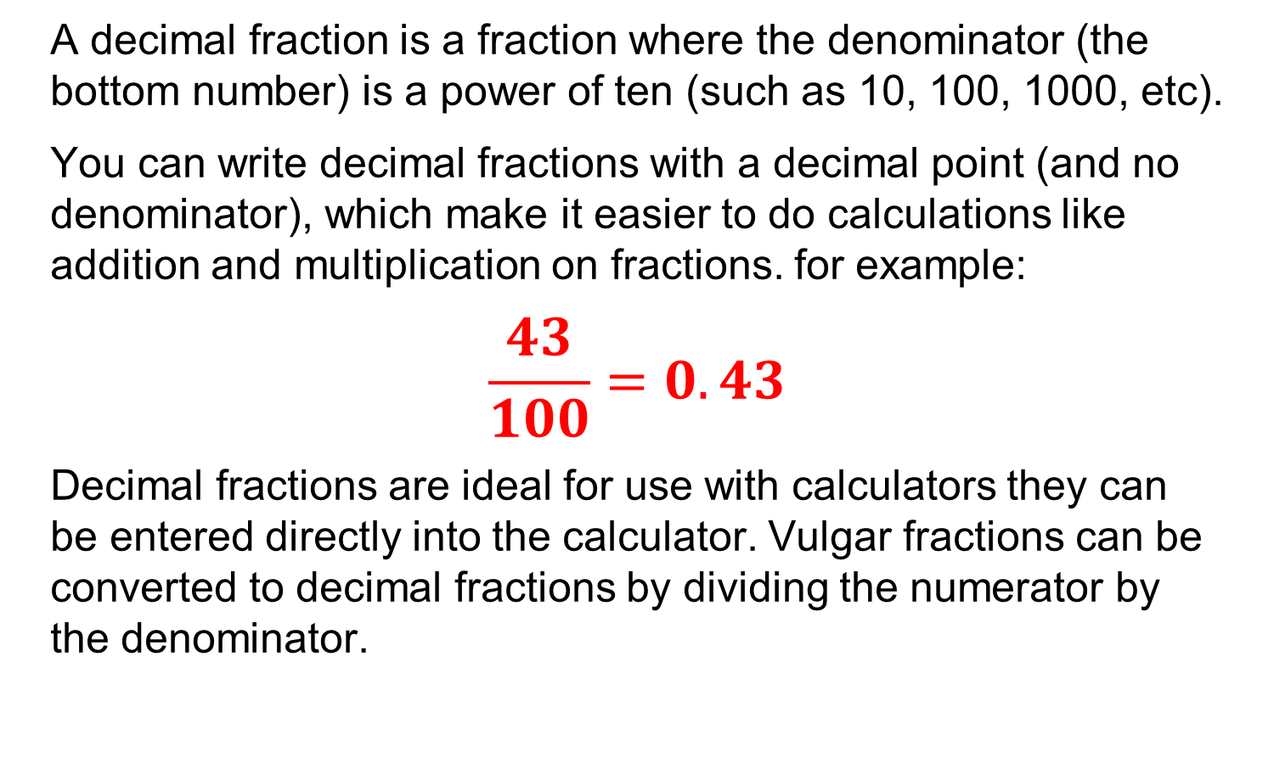
Decimal fractions
A decimal fraction is a fraction where the denominator (the bottom number) is a power of ten (such as 10, 100, 1000, etc).
You can write decimal fractions with a decimal point (and no denominator), which make it easier to do calculations like addition and multiplication on fractions. for example:
$$\frac{43}{100}=0.43$$
Decimal fractions are ideal for use with calculators they can be entered directly into the calculator. Vulgar fractions can be converted to decimal fractions by dividing the numerator by the denominator.

Slide 6
Percentages
‘Percent’ means out of 100. The current basic income tax rate is 20 per cent taxable pay, this means that for £100 you will have to pay £20 in income tax. The symbol % means per cent.
How to calculate a percentage.
A percentage is a fraction with a denominator of 100.
60% (60 in each 100) as a fraction is 60/100
60% as a decimal is 0.6.
You will frequently need to find a percentage of a quantity.
First, write the percentage as a fraction or a decimal, then multiply by the quantity.

Slide 7
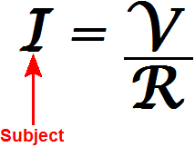
Transposition of formulae
This is also known as ‘changing the subject of the formula’.

Slide 8
Rules for transposition
Whatever you do to one side of the formula you must do the same to the other side. In other words:
add the same quantity to both sides of the formula
subtract the same quantity from both sides of the formula
multiply both sides of the formula by the same quantity
divide both sides of the formula by the same quantity
take ‘functions’ of both sides of the formula; for example, square both sides or ﬁnd the reciprocal of both sides.
This is a lot to remember in one go but do not worry! Keep referring back to these as you work through the examples. Practice makes perfect!

Slide 9
Example 1
I | = | V R
The question is: ‘Make V the subject of the formula’. This means that ‘V’ must be put on its own on one side of the equals sign and the other terms must be on the other side.
In order to do this, first multiply both sides by R:
I × R | = | V × R R
Now cancel through:
I × R | = | V × R R
I × R | = | V
Now reverse the formula:
V | = | I × R

Slide 10
Example 2
I | = | V R
The question is: ‘Make R the subject of the formula’. This means that ‘R’ must be put on its own on one side of the equals sign and the other terms must be on the other side.
In order to do this, first multiply both sides by R:
I × R | = | V × R R
Now cancel through:
I × R | = | V × R R
I × R | = | V

Slide 11
Example 2
Now divide both sides by I:
I × R I . | = | V I
Now cancel through:
I × R I . | = | V I
R | = | V I

Slide 12
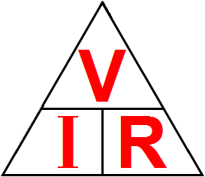
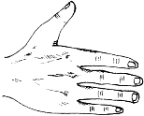
Ohm’s law triangle
In order to find the formula for ‘V’, cover ‘V’ in the triangle.
What’s left is the formula:
V = I × R

Slide 13

Ohm’s law triangle
In order to find the formula for ‘I’, cover ‘I’ in the triangle.
What’s left is the formula:
I = V R

Slide 14
Ohm’s law triangle
In order to find the formula for ‘R’, cover ‘R’ in the triangle.
What’s left is the formula:
R = V I

Slide 15
Example 3
E | = | B × l × v
The question is: ‘Make v the subject of the formula’. This means that ‘v’ must be put on its own on one side of the equals sign and the other terms must be on the other side.
E . B × l. | = | B × l × v B × l
In order to do this, first divide both sides by B × l:
Now cancel through:
E . B × l. | = | B × l × v B × l
E . B × l. | = | v
Now reverse the formula:
v | = | E . B × l

Slide 16
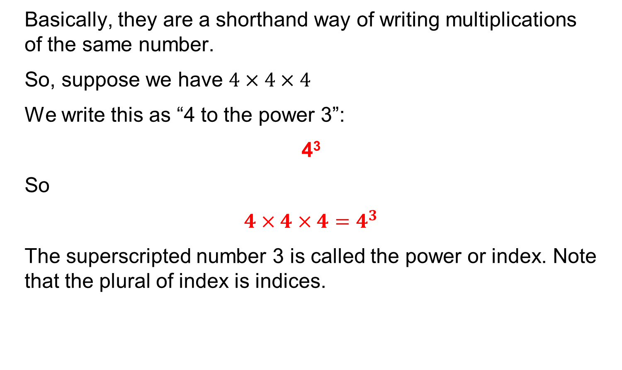
Indices
Basically, they are a shorthand way of writing multiplications of the same number.
So, suppose we have $4×4×4$
We write this as “4 to the power 3”:
4³
So
$$4×4×4=4^{3}$$
The superscripted number 3 is called the power or index. Note that the plural of index is indices.

Slide 17
Indices
Indices can be positive or negative and we generally use them in electrical science to express very large or very small numbers easily.
For example, a typical microwave motion detector uses a frequency of 2 420 000 000Hz. If you were to have to write numbers of this magnitude or input them into a calculator regularly it would be quite a chore. By using indices, the number could be written as:
2.42 x 10⁹ Hz
Effectively, the 10⁹ means that the decimal place, which is initially at the extreme right of the number, is moved 9 places to the left.

Slide 18
Indices
Another example is that the resistivity of copper is 0.000 000 017 2 ohm/metre³. Again, to write and input these numbers would be quite a chore. By using negative indices, the number could be written as:
17.2 10⁻⁹ ohm/metre³
Effectively, the 10⁻⁹ means that the decimal place, which is initially at the left end of the number, is moved 9 places to the right.

Slide 19
Notation
Standard Form or Scientific Notation: A number written with one digit to the left of the decimal point and multiplied by 10 raised to some power is written in standard form or with scientific notation. For example:
43712 = 4.3712 x 10⁴
0.036 = 3.6 x 10⁻²
Engineering Notation: is like scientific notation except that the power of ten is always a multiple of 3. For example:
43712 = 43.712x 10³ = 0.043712 x 10⁶
0.036 = 36 x 10⁻³ = 36000 x 10⁻⁶
In electrical installation, we generally use engineering notation.

Slide 20
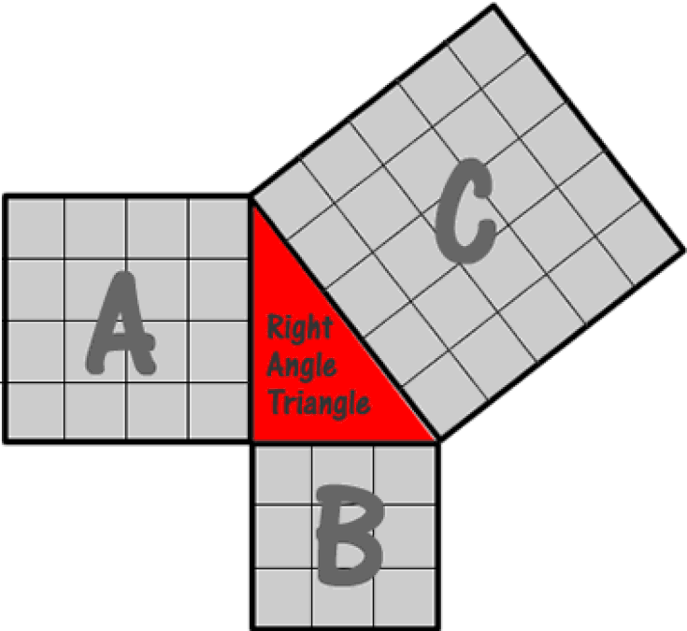
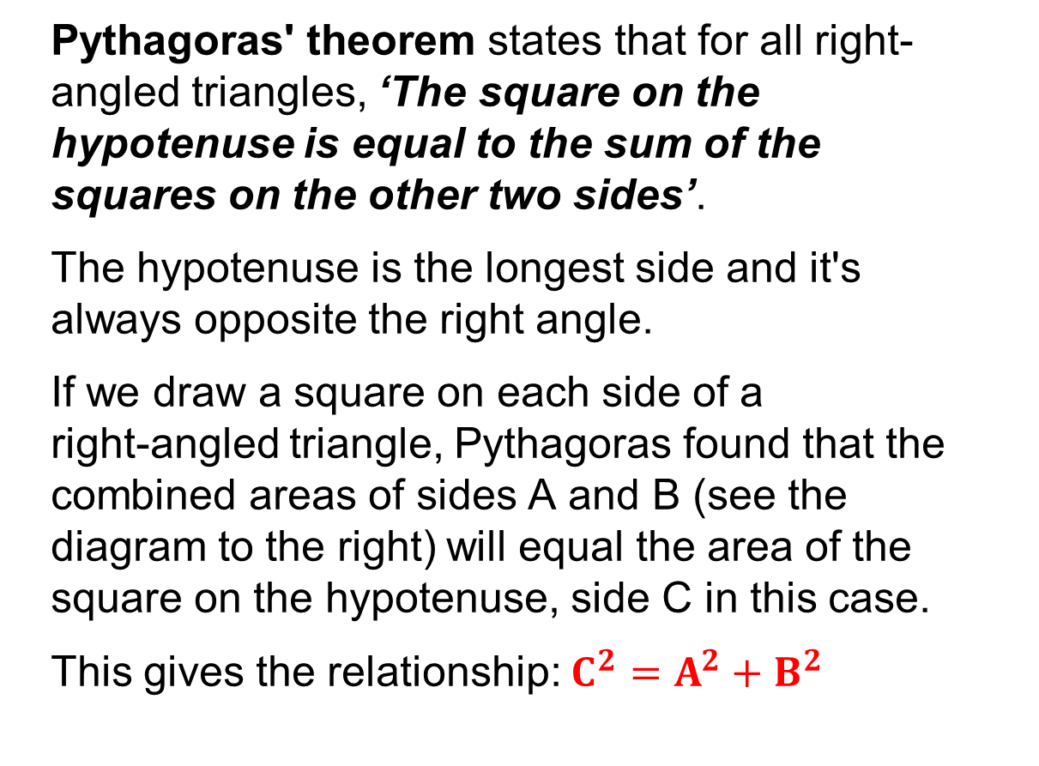
Triangles
Pythagoras' theorem states that for all right-angled triangles, ‘The square on the hypotenuse is equal to the sum of the squares on the other two sides’.
The hypotenuse is the longest side and it's always opposite the right angle.
If we draw a square on each side of a right‑angled triangle, Pythagoras found that the combined areas of sides A and B (see the diagram to the right) will equal the area of the square on the hypotenuse, side C in this case.
This gives the relationship: $C^{2}=A^{2}+B^{2}$

Slide 21
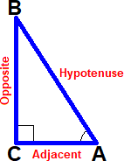
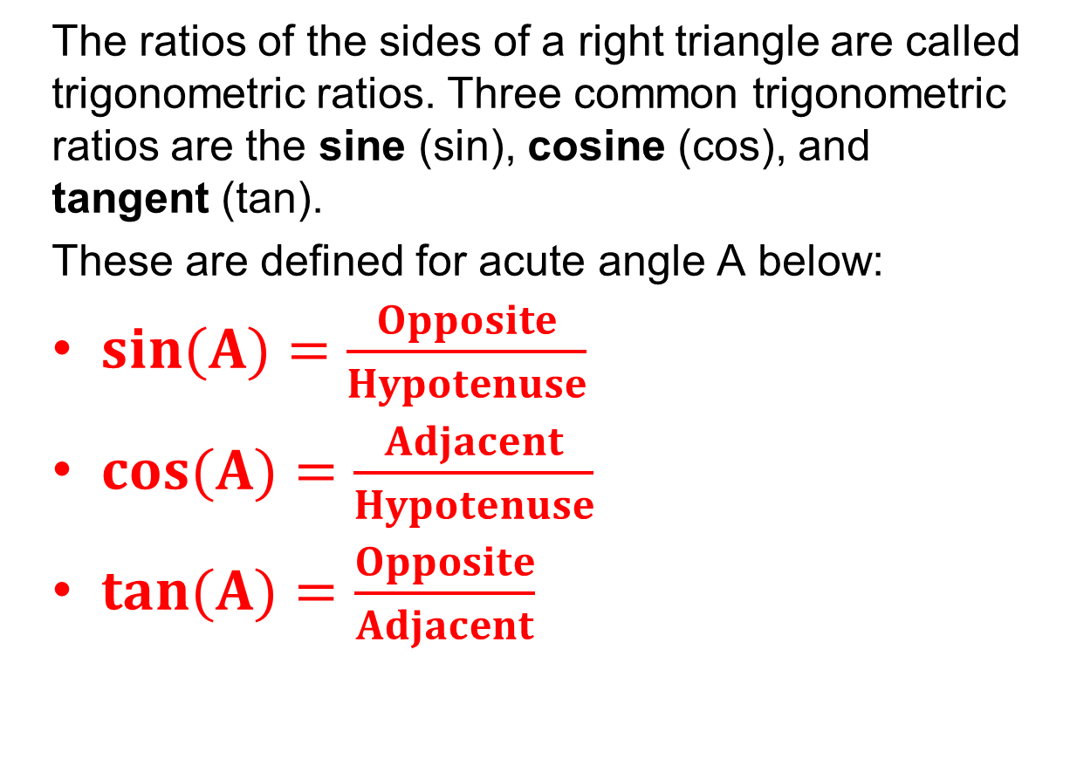
Trigonometry
The ratios of the sides of a right triangle are called trigonometric ratios. Three common trigonometric ratios are the sine (sin), cosine (cos), and tangent (tan).
These are defined for acute angle A below:
$sin(A)=\frac{Opposite}{Hypotenuse}$
$cos(A)=\frac{Adjacent}{Hypotenuse}$
$tan(A)=\frac{Opposite}{Adjacent}$

Slide 22
Statistics
This is a branch of mathematics dealing with the collection, analysis, interpretation, presentation, and organization of data. We would normal start with data collection which could be, for example, the number of people with red cars, blue cars, silver cars or white cars; this is referred to as the population.
Once the data has been collected it can then be analysed using simple statistical tools including ‘range’, ‘average’ (‘mean’), ‘median’ and mode.

Slide 23
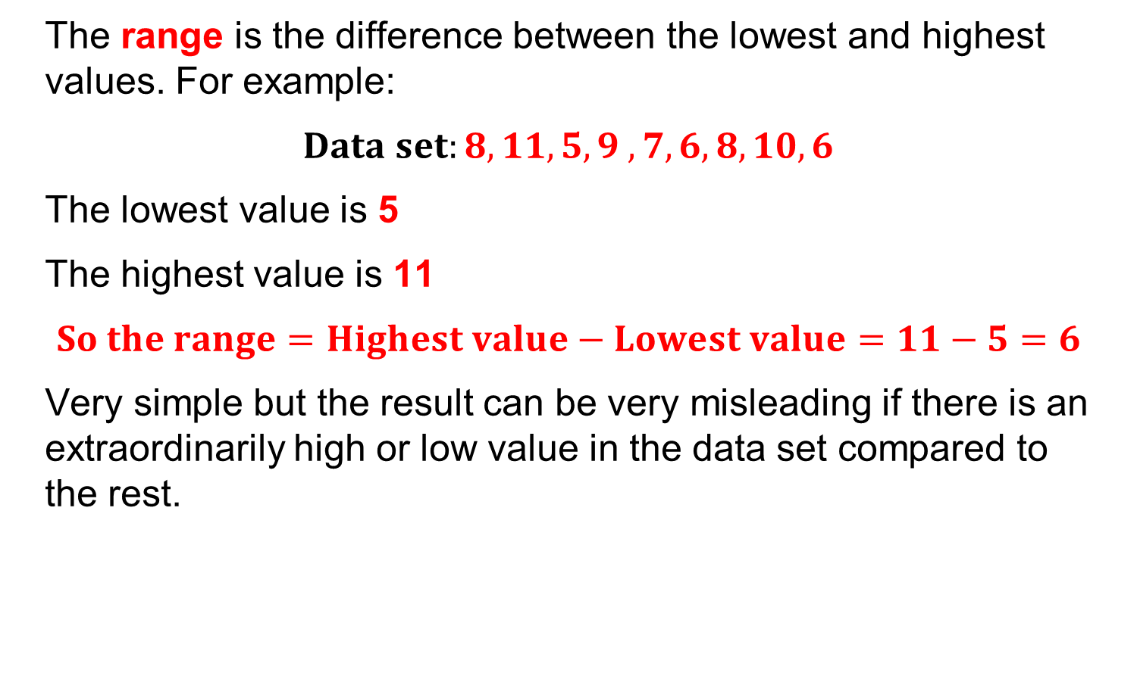
Statistics
The range is the difference between the lowest and highest values. For example:
$$Data set:8, 11, 5, 9 , 7, 6, 8, 10, 6$$
The lowest value is 5
The highest value is 11
$$So the range=Highest value−Lowest value=11−5=6$$
Very simple but the result can be very misleading if there is an extraordinarily high or low value in the data set compared to the rest.

Slide 24
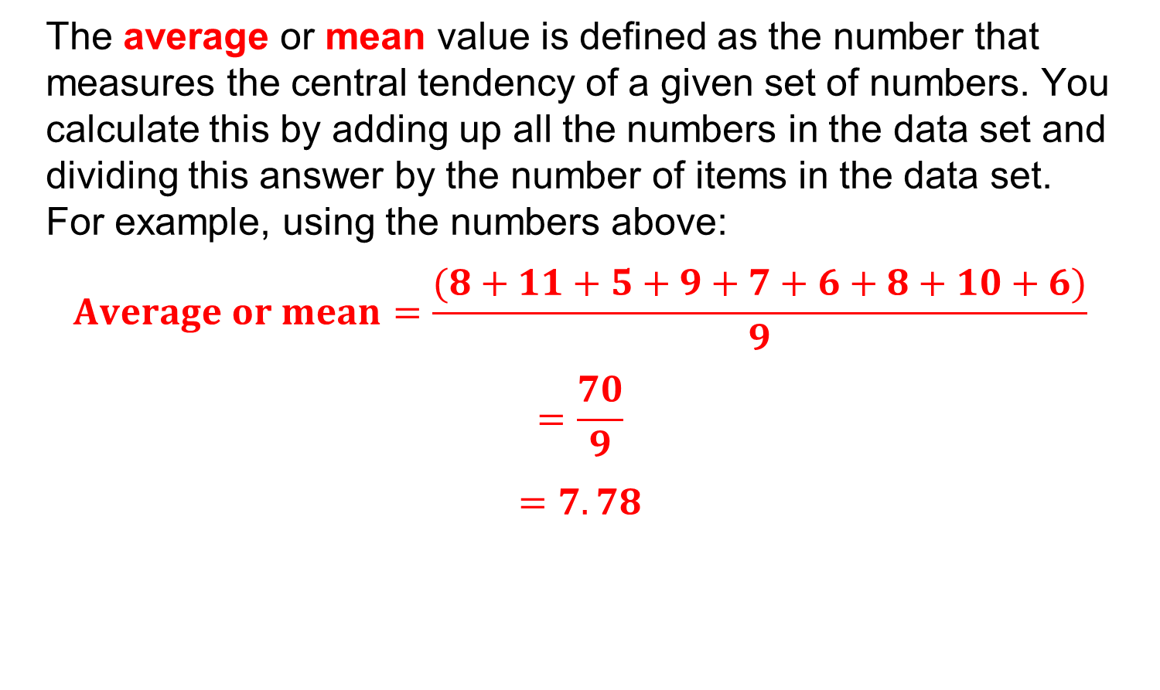
Statistics
The average or mean value is defined as the number that measures the central tendency of a given set of numbers. You calculate this by adding up all the numbers in the data set and dividing this answer by the number of items in the data set. For example, using the numbers above:
$$Average or mean=\frac{(8+11+5+9+7+6+8+10+6)}{9}$$
$$=\frac{70}{9}$$
$$=7.78$$

Slide 25

Statistics
The median is the middle value of a data set. To find the median, list the values of the data set in numerical order and identify which value appears in the middle of the list. For example, again using the data set above:

Slide 26
Statistics
The mode is the value that occurs the most and there can be more than one. For example, using the data set above it can be seen that the values that occur the most is 6 and 8 with two of each so these are the mode values.

Slide 27
Unit 202: Principles of electrical science
The End

